Slide 1
Data Structures
Jiexin Wang
School of Software Engineering
South China University of Technology

Slide 2
Chapter 3
Lists, Stacks and Queues

Slide 3
Content
List
Stack
Queue

Slide 4

List

Slide 5
What is List
A list is a finite, ordered sequence of data items called elements.
  Notation: <a₀, a₁, …, a_{n-1}>
  Each element has a position in the list.
  Each element may be of arbitrary type, but all are of the same type
  The length of a list is the number of elements currently stored
    An empty list contains no elements
  The beginning and the end of the list are, respectively, called the head and the tail
  Common List operations are:
    insert, append, delete/remove, find, isEmpty, currPos, prev, next, moveToPos, moveToStart, length, etc

Slide 6
List ADT
// List ADT (abstract class in C++)
template <typename E> class List {
public:
List() {}
virtual ~List() {}
virtual bool insert(const E& item) = 0;
//Append an element at the end.
//Return true if successful, false if the list is full.
virtual bool append(const E& item) = 0;
virtual bool remove(E&) = 0;
virtual void clear() = 0;
virtual void moveToStart() = 0;
virtual void moveToEnd() = 0;
virtual void prev() = 0;
virtual void next() = 0;
virtual int currPos() const =0;
virtual void moveToPos(int pos) = 0;
……
}

Slide 7
List ADT
// List ADT (abstract class in C++)
template <typename E> class List {
public:
List() {}
virtual ~List() {}
virtual bool insert(const E& item) = 0;
//Append an element at the end.
//Return true if successful, false if the list is full.
virtual bool append(const E& item) = 0;
virtual bool remove(E&) = 0;
virtual void clear() = 0;
virtual void moveToStart() = 0;
virtual void moveToEnd() = 0;
virtual void prev() = 0;
virtual void next() = 0;
virtual int currPos() const =0;
virtual void moveToPos(int pos) = 0;
……
}
The key design decision in this ADT: the concept of a current position.
<38,99,|11,72>
insert 50
<38,99,|50,11,72>
prev()
<38,|99,50,11,72>
remove
<38,|50,11,72>

Slide 8
List Implementation
// List ADT (abstract class in C++)
template <typename E> class List {
public:
List() {}
virtual ~List() {}
virtual bool insert(const E& item) = 0;
//Append an element at the end.
//Return true if successful, false if the list is full.
virtual bool append(const E& item) = 0;
virtual bool remove(E&) = 0;
virtual void clear() = 0;
virtual void moveToStart() = 0;
virtual void moveToEnd() = 0;
virtual void prev() = 0;
virtual void next() = 0;
virtual int currPos() const =0;
virtual void moveToPos(int pos) = 0;
……
}
Two standard list implementations
  Array-based lists
  Pointer-based lists (Linked lists)

Slide 9
List: Array Implementation
Basic Idea:
  Pre-allocate a big array listArray of size maxSize
  Keep track of current size using a variable listSize
  Keep track of current position using a variable curr_position
  Shift elements when you have to insert or remove
0
1
2
3
…
listSize-1
maxSize
A₁
A₂
A₃
A₄
…
A_{N}

Slide 10
List: Array Implementation
insert Z in kth position
0
1
2
3
4
5
maxSize
A
B
C
D
E
F
0
1
2
3
4
5
6
maxSize
A
B
Z
C
D
E
F
Running time for N elements?
On average, must move half the elements to make room – assuming insertions at positions are equally likely
Θ(N)
Worst case is insert at position 0. Must move all N items one position before the insert
Quickly?
This is Θ(N) running time.
Best case?
Θ(1)

Slide 11
List: Array Implementation
insert the element at position curr
  Shift left n-i-1 elements toward the tail
// insert element at the current position
void insert(const E& it) {
Assert(listSize<maxSize, “Exceed capacity”);
//shift Elements up
for(int i=listSize; i>curr; i--)
listArray[i] = listArray[i-1];
listArray[curr] = it; // insert the element
listSize++; // increment list size
}

Slide 12
List: Array Implementation
remove the element at position curr
  Shift left n-i-1 elements toward the head
// Remove and return the current element
E remove() {
Assert((curr>=0)&&(curr<listSize), “no element);
E it = listArray[curr]; // Copy the element
for(int i=curr; i<listSize-1; i++)
// Shift them down
listArray[i] = listArray[i+1];
listSize--; // Decrement size
return it;
}
Time cost – Θ(1) for best case; Θ(n) for worst- and average cases

Slide 13
List: Array Implementation
bool moveToPos(int pos) {
Assert((pos>=0)&&(pos<listSize)), “out of range);
curr = pos;
}
void moveToStart() { curr = 0; } //reset position
void moveToEnd() { curr = listSize; } //set at end
void prev() { if(curr!=0) curr--; }
void next() { if(curr < listSize) curr++; }
int Length() const { return listSize; }
int currPos() const { return curr; }
Other operations
Time cost – Θ(1) for best, worst- and average cases

Slide 14
List: Array Implementation
Search for a value K in the list
//Return true if K is in list, otherwise,false
bool find(List<int>& L, int K) {
int it;
for(L.moveToStart(); L.currPos()<L.Length(); L.next()) {
it = getValue(); //return value of curr element
if (K == it) return true; // Found it
}
return false; // Not found
}
Time cost – Θ(1) for best case; Θ(n) for worst- and average cases
insert，remove，find

Slide 15
List: Array Implementation
C++ STL – Vector
  A growable array implementation of the List ADT
    How to provide a grow-able array implementation of the List ADT
  Textbook section 3.3，3.4 vector & Code vector.h and TestVector.cpp

Slide 16

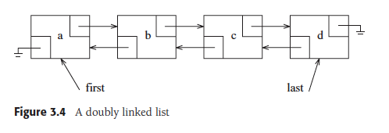
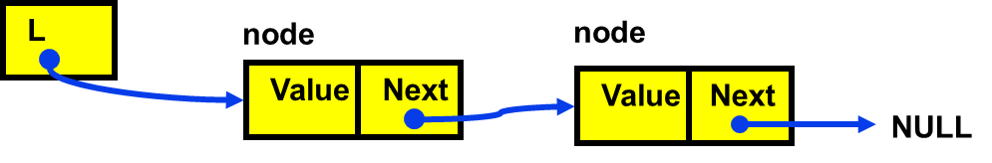
List: Pointer Implementation
Linked list
  Use dynamic memory allocation which allocates memory for new list elements as needed
  A linked list is made up of a series of objects, called the nodes of the list. The nodes are linked using pointers.
    Keep track of list by linking the nodes together
  Change links when you want to insert or delete

Slide 17
List: Pointer Implementation
// An implementation of a simple
// singly-linked list node
template <typename E> class Link {
public:
E element; //value for this node
Link *next; //Pointer to next node in list
//Constructors
Link(const E& elemval, Link* nextval =NULL)
{element = elemval; next = nextval; }
Link(Link* nextval =NULL)
{ next = nextval; }
};

Slide 18


List: Pointer Implementation
Keep track of the following four information in linked list
  head pointer – for scanning the whole list
  tail pointer – to speed up “append” operation
  curr pointer – pointing to the current element (two design options)
  cnt value – store the length of the list
VS.
Which is better？

Slide 19
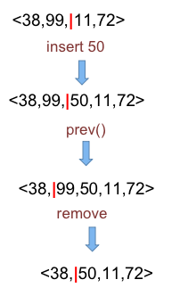
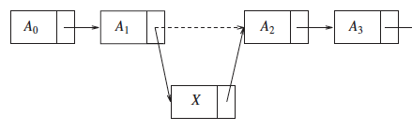

List: Pointer Implementation
Insertion

Slide 20
List: Pointer Implementation
Insertion
  With curr points to the node after the current position

Slide 21

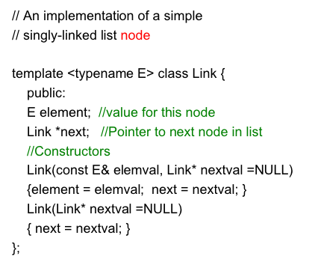
List: Pointer Implementation
Insertion
  With curr points to the node preceding the current position （better）

Slide 22
List: Pointer Implementation
  //Class LList
  //inherit the abstract class List
template <typename E> class LList: public List<E>{
private:
Link<E>* head; //Pointer to list header
Link<E>* tail; //Pointer to last element
Link<E>* curr; //last element on the left side
int cnt; //Size of list
void init() //used by constructor
{ curr = tail = head = new Link<E>; cnt =0;}
void removeall() //used by deconstructor
{ while(head != NULL) {
curr=head; head=head->next; delete curr;
}
}
}

Slide 23
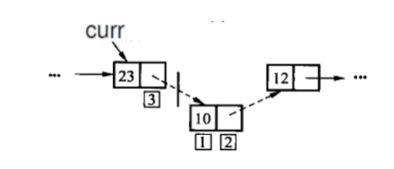
List: Pointer Implementation
Linked List – Insertion
  Three-step insertion process
    Create a new list node, store the new element
    Set the next field of the new node
    set the next field of the node pointed by curr

Slide 24
List: Pointer Implementation
//Insert a node to current position
public:
void insert(const E& it) {
curr->next = new Link<E>(it, curr->next);
if (tail == curr) tail = curr->next; //new tail
cnt++;
}
//Append a node at the tail of the list
void append(const E& it) {
tail = tail->next = new Link<E>(it, NULL);
cnt++;
}
Time cost – Θ(1)

Slide 25
List: Pointer Implementation
Linked List – Removal
  Removing a node only requires to redirect some pointers around the node to be deleted.
  Remember to reclaim the space occupied by the deleted node

Slide 26
List: Pointer Implementation
// Remove and return current element
E remove() {
E it = curr->next->element;
Link<E> *ltemp = curr->next;
if (tail == curr->next)
tail =curr; // Reset tail
curr->next = curr->next->next; //remove element
delete ltemp; //reclaim space
cnt--; //decrement the list size
return it;
}
Time cost – Θ(1)

Slide 27
List: Pointer Implementation
Linked List – Position Ops
//Next – move curr one pos toward the tail
void next() { // no change if already at end
if (curr != tail) { curr = curr->next;}
}
//Prev – move curr one pos toward the head
void prev() {
if (curr == head) return; // No previous element
Link<E>* temp = head;
//march down list until the previous element
while (temp->next!=curr) temp=temp->next;
curr = temp;
}
Time cost: Θ(1) for next;
Θ(n) for prev in the average and worst cases.

Slide 28
List: Pointer Implementation
C++ STL – List
  a doubly linked list implementation of the List ADT
    How to implement the list ADT with pointers where Prev method takes Θ(1) time?
  Textbook section 3.5 list & Code list.h and TestList.cpp

Slide 29
Comparison of
List Implementations
Array-Based List |  | Linked List
Predetermine the size before allocation. |  | Space is allocated on demand; No limit to the element number. | √
No waste space for an individual element. | √ | Require to add an extra pointer to every list node.
Random access and Prev takes Θ(1) time | √ | Random access and Prev takes Θ(n) time
Insertion and deletion takes Θ(n) time. |  | Insertion and deletion takes Θ(1) time. | √

Slide 30
Comparison of
List Implementations
linked lists are more space efficient when implementing lists whose number of elements varies widely or is unknown.
Array-based lists are generally more space efficient when the user knows in advance approximately how large the list will become.

Slide 31
Comparison of
List Implementations
Comparison formula
  The number of element currently in the list – n;
  The size of a pointer – P
  The size of a data element – E
  The maximum number of elements in the array – D
The array-based list requires space DE
The linked list requires space n(P+E)
When n> DE/(P+E), the array-based list is more space efficient!

Slide 32
Exercise
Determine the break-even point for a linked list being more efficient than an array-based list
  The data field is 2 bytes, a pointer is 4 bytes, the array has 30 elements
    n < DE/(P+E) = 2*30/(2+4) = 10
  The data field is 8 bytes, a pointer is 4 bytes, the array has 30 elements
    n < DE/(P+E) = 8*30/(8+4) = 20
  The data field is 32 bytes, a pointer is 4 bytes, the array has 40 elements
    n < DE/(P+E) = 32*40/(32+4) = 35.555

Slide 33

Stack

Slide 34
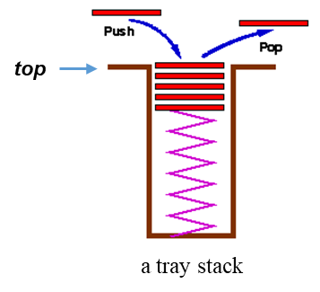
What is Stack
A list for which Insert and Delete are allowed only at one end of the list (the top)
  the implementation defines which end is the "top"
  LIFO – Last in, First out
Push: Insert element at top
Pop: Remove and return top element (aka TopAndPop)
IsEmpty: test for emptyness

Slide 35
Two Basic Implementations of Stacks
Array-based
  The k items in the stack are the first k items in the array.
Linked List

Slide 36
Stack ADT
// The stack ADT
template <typename E> class Stack {
private:
void operator=(const Stack&) {} //Protect assignment
Stack(const Stack&) {} //Protect copy assignment
public:
// Push an element onto the top of the stack.
virtual bool push(const E& it) = 0;
// Remove the element at the top of the stack.
virtual E pop() = 0;
// Return a copy of the top element
virtual const E& topValue() const = 0;
};

Slide 37
Array-Based Stacks
Array-based stack implementation
  The stack must be declared of fixed size
  A simplified version of the array-based list
Template <typename E> class Astack: public Stack<E> {
private:
int maxSize; // Maximum size of stack
int top; // Index for top element (free position)
E *listArray; // Array holding stack elements
public:
AStack(int size=defaultSize) //Constructor
{ maxSize=size; top=0; listArray=new E[size]; }
~Astack() { delete [] listArray; } //Destructor
Which end of the array shall be the top of the stack?

Slide 38
Array-Based Stacks (III)
Make the tail of the array be the top of the stack
  Pushing an element onto the stack by appending it to the tail of the list
  The cost for each push and pop operation is simply Θ(1).
Setting of top
  The array index of the first free position in the stack
    An empty stack has top set to 0.
  Push: first insert the element, then increment top
  Pop: first decrement top, then removes the top element;
    Pay attention to the order of two operations

Slide 39
Array-Based Stacks (II)
void clear() { top=0; } //Reinitialize
void push(const E& it) { // put “it” on stack
Assert(top != maxSize, “Stack is full”);
listArray[top++] = it; }
E pop() {//pop top element
Assert(top != 0, “Stack is empty”);
return listArray[--top]; }
const E& topValue() const { //return top element
Assert(top != 0, “Stack is empty”);
return listArray[top-1]; }

Slide 40
Linked Stacks
Elements are inserted and removed only from the head of the list
//A linked stack
template <typename E> class LStack: public Stack<E> {
private:
Link<E>* top; //pointer to first element
int size; //number of elements
public:
LStack(int sz = defaultSize){ //Constructor
top = NULL; size = 0;
}
~LStack() { clear(); } //Destructor

Slide 41
Linked Stacks (II)
E pop() { //remove “it” from stack
Assert(top != NULL, “Stack is empty”);
E it = top->element;
Link<E>* ltemp = top->next;
delete top; top = ltemp; size--; return it;
}
const E& topValue() const { //return top value
Assert(top != 0, “Stack is empty”);
return top->element;
}
void clear() { //reinitialize
while (top != NULL) { //delete link nodes
Link<E>* temp = top; top = top->next; delete temp;
}
size = 0;
}
void push(const E& it) { //put “it” on the stack
top = new Link<E>(it, top); size++;
}

Slide 42
Linked Stacks (III)
No need to have a head node
  No special code is required for lists of zero or one elements.
A pointer top points to the first link node
  Push: first modifies the next field of the newly created node to point to the top of the stack, then sets top to point to the new node
  Pop: set top to point to the next link of the old top node; the old top node is freed and its element value is returned.

Slide 43
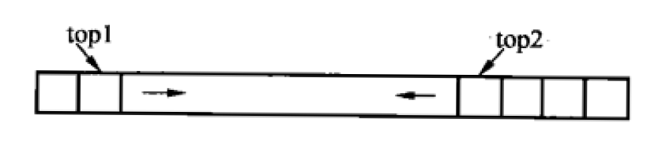
Comparison of Array-Based and Linked Stacks
 | Array-Based Stack | Linked Stack
Implementation | Take the end of array as the top of stack | Take the head of linked list as the top of stack
Time cost | Constant time for push, pop, topValue; Constant time for clear | Constant time for push, pop and topValue; Linear time for clear
Space cost | Waste some space when the stack is not full - Overflow possible | Require the overhead of a link field for every element
Q: How to implement two stacks using a single array?

Slide 44

Queue

Slide 45
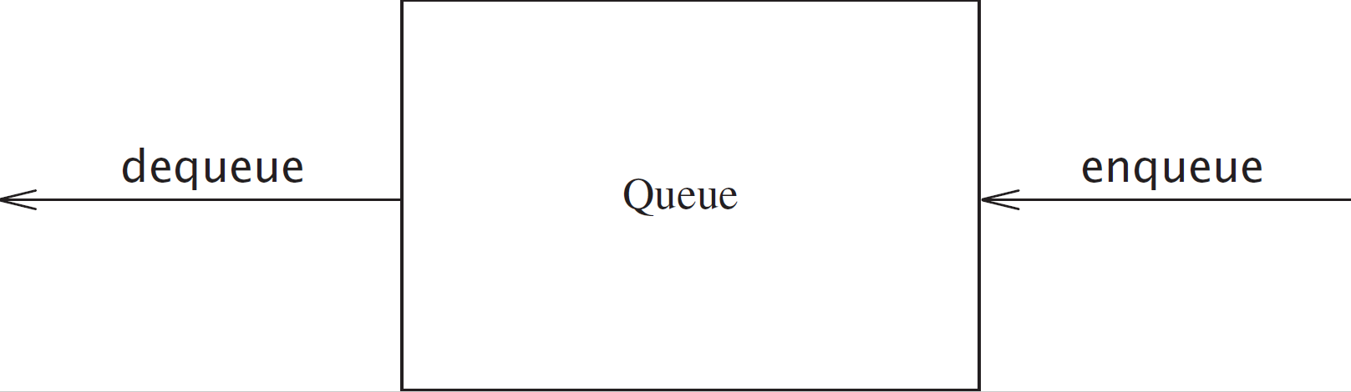
What is Queue
In a queue, elements may only be inserted from one end (back) of the list and removed from the other end (front) of the list
  First-In, First-Out
  Enqueue: insert an element at the back
  Dequeue: remove an element from the front

Slide 46
Queue ADT
  template <typename E> class Queue {
  private:
  void operator =(const Queue&) {}
  Queue(const Queue&) {};
  public:
  Queue() {}
  virtual ~Queue() {}
  virtual void clear() = 0;
  virtual void enqueue(const E&) = 0;
  virtual E dequeue() = 0;
  virtual const E& frontValue() const = 0;
  virtual int length() const = 0;
  }

Slide 47
Two Implementations of Queue
The array-based queue
The linked queue

Slide 48
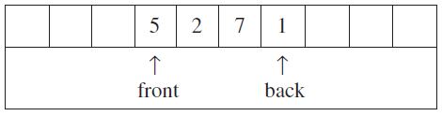
Queue: Array Implementation
  //Array Implementation for Queue
  template <typename E> class AQueue: public Queue<E> {
  private:
  int maxSize; // Maximum size of queue
  int front; // Index of front element
  int rear; // Index of back element
  E *listArray; // Array holding queue elements
  int currSize; //length of queue
  …
  };
rear

Slide 49
Array-Based Queues
Suppose we store n elements in the first n positions of the array
  If we choose position n-1 in the array as the front of the queue
    Dequeue requires only Θ(1) time, but enqueue costs Θ(n) time
  If we choose position 0 in the array as the front of the queue
    Dequeue costs Θ(n) time, while enqueue costs Θ(1) time

Slide 50
Array-Based Queues
An efficient and tricky implementation
  The queue is still required to be stored in contiguous array positions
  The queue position can drift within the array

Slide 51
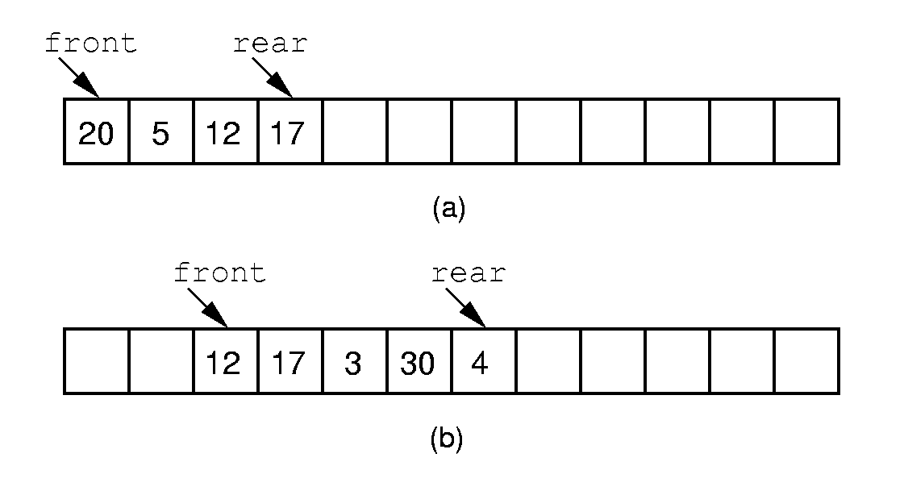
Array-Based Queues
Drifting queue
  The front of the queue is initially at position 0 of the array
  The elements are added to successively higher-numbered positions
  When elements are removed, the front index increases
  Both enqueuer and dequeuer cost Θ(1) time
Problem?

Slide 52
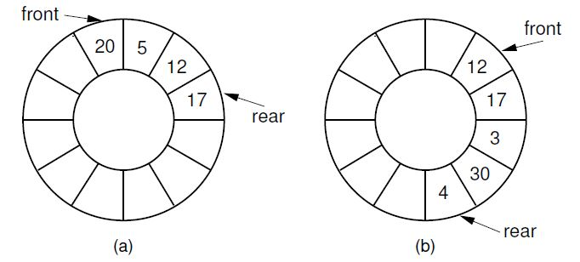
Array-Based Queues
Circular queue
Easily implemented using the modulus operator（%）
  Position maxSize-1 immediately precede position 0（maxSize%maxSize）

Slide 53
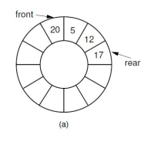
Array-Based Queues
Circular queue
  How to recognize whether the queue is empty or full?

Slide 54
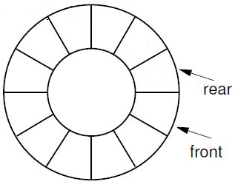
Array-Based Queues
Circular queue
  How to recognize whether the queue is empty or full?

Slide 55
Array-Based Queues
When front = rear, there has one element in the queue
When front is one larger than rear, the queue is empty or full?
  Solution 1: explicitly keep a count of the number of elements in the queue
  Solution 2: make the array be of size n+1 and only allow n elements to be stored.
    front = rear+1, the queue is empty
    front = rear+2, the queue is full.

Slide 56
Array-Based Queues
//Array-based Implementation (solution 2)
template <typename E> class AQueue: public Queue<E> {
  private:
  int maxSize; // Maximum size of queue
  int front; // Index of front element
  int rear; // Index of rear element
  E *listArray; //Array holding queue elements
  public:
  AQueue(int size =defaultSize) {
  // Constructor- Make list array one position
  // larger for empty slot
  maxSize = size+1;
  rear = 0; front = 1;
  listArray = new E[maxSize];
  }
  ˜ AQueue() { delete [] listArray; }

Slide 57
Array-Based Queues
//reinitialize
void clear() {rear = 0; front = 1;}
void enqueue(const E& it) {//put “it” in queue
Assert(((rear+2) % maxSize) != front,
“Queue is full”);
rear = (rear+1)%maxSize;
listArray[rear] = it;
}
E dequeue() {//take element out
Assert(length() != 0, “Queue is empty”);
E it = listArray[front];
front =(front+1)%maxSize;
return it;
}

Slide 58
Array-Based Queues
//get front value
const E& frontValue() const {
Assert(length()!=0, “Queue is empty”);
return listArray[front];
}
//return length
virtual int length() const {
return ((rear+maxSize)-front+1)%maxSize;
}

Slide 59
Linked Queues
A straightforward adaptation of the linked list
Structures
  Use a header node
  The front pointer points always points to the header node
  The rear pointer points to the last link node in the queue
Operations
  Enqueue: places the new element in a link node at the end of the linked list, advances rear to point to the newly-inserted node
  Dequeue: removes and returns the first element of the list

Slide 60
Comparison of Array-Based and Linked Queues
Time cost
  All member functions for both implementations require constant time Θ(1)
Space cost
  For array-based queues, there are some space waste if the queue is not full.
  For linked queues, there are overhead of link field in each element.

